Slide 1
MODULE 5

Slide 2
Topics
Replication Technologies
  Synchronous
  Asynchronous
Where to perform replication…?
  Application/Database layer
  Host layer (Logical Volume Manager in Linux)
  Hypervisor layer
  Storage array layer

Slide 3
Replication: Synchronous[1]
Synchronous
All write to a volume are committed to both the source and the remote replica before the write is considered complete
  Provides zero data loss i.e. RPO (Recovery Point Objective) of zero
  Negative impact on performance
Replication Distance and latency
  No. of routers that have to be traversed
  Distance between the source and target
    e.g. ping can be used to find end to end latency

Slide 4
Replication: Synchronous[2]
Replication link Considerations
  Requires robust and reliable network links
    Deployment of multiple diverse replication networks is common practice to handle unreliable links
  Sizing network bandwidth for peak traffic including bursts
    During high bursts additional latency will be added to each write transaction without peak provisioning
  For shared IP networks (link is shared between replication and other application traffic) policing or bandwidth throttling should be used

Slide 5
Replication: Asynchronous
No overhead to write transactions
  Transactions are signaled as complete as soon as they are committed to the source volume
  Copying transaction to the target is performed asynchronously
    Potential for data loss to occur
    Exact loss depends upon the technology involved
      15 minutes lag is common among existing technology
  Distance between source and replica can be far larger than synchronous replication
    RTT (Round Trip Time) is not so important here
  Sizing network bandwidth for peak traffic is not required

Slide 6
Where to perform replication?
Layers of storage stack where replication is commonly performed
  Application/Database layer
  Host layer (Logical Volume Manager in Linux)
  Hypervisor layer
  Storage array layer

Slide 7
Application Layer Replication
Replication load on application server
  Not a big deal with advancement in CPU technology
Application aware replication
  Replication technology is tightly coupled with the application
  Replicas are in an application consistent state
    Quick and effective recovery process
    e.g. Oracle data Guard, Native application technology comes with Microsoft Application Server and Microsoft Exchange Server

Slide 8
Replication: Oracle Data Guard
DG replicas are transactionally consistent
DG Configuration (One primary + one or more standby)
  Production data base known as Primary
  Remote recovery copy is known as Standby
DG’s Log Shipping Technology
Logs
Logs
DB
DB
Log Replay
Production Site
DR Site

Slide 9
Data Guard: Standby databases
Physical
  Exact physical copy of the primary database with identical on-disk block layout
Logical
  Data is same as primary but on-disk structures and database layout will be different
    Redo logs are converted into SQL statements that are then executed against the standby database
Logical standby DB is more flexible than physical standby DB
  It can be used more than just DR
Oracle DB allows both switchover and failover
  Switchover = Manual transition from standby to primary
  Failover = Automatic transition when primary DB fails

Slide 10
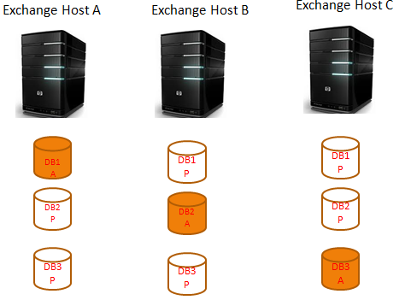
Replication: MS Exchange Server
Active/Passive Architecture
  Allows more than one standby copy of a database
  Also, utilizes log shipping
  Supports both switch-over and fail-over
  Fundamental unit of replication is the Data Availability Group (DAG) (i.e. collection of exchange servers)
  Recovery method
    At database level

Slide 11
Replication- Logical Volume Manager Based
Host based volume manager for remote replication using LVM mirrors
  e.g. Linux LVM
LVM is agnostic about the underlying storage technology
  LVM can be considered as a thin software layer on top of the hard disks and partitions
    Ease the Disk replacement, repartitioning, backup, and migration
  used for storage migration by people

Slide 12
Replication-Hypervisor based
Hypervisor based replication
  e.g. vSphere Replication from VMware using Site Recovery Manager (SRM)
    Agnostic about the underlying storage technology
    IP based replication technology, works at the VM disk (VMDK) level
    Provides replication at very granular level
    e.g. Imagine a VM with four virtual disks
      VMDK 1: OS partition, VMDK 2: Page file partition, VMDK 3: Database partition, VMDK 4: Scratch partition
      Based on network b/w availability at VMDK level replication can be configured
    Allows incremental backups to save b/w
Notes:
Even source and target array may have different technology

Slide 13
Replication-Storage Array based
Replication responsibility is of storage not the applications
  Positive
    Applications are offloaded
  Negative
    State of the application data in the remote replica volume will not be ideal for the application to recover from
    Applications may require to do additional work
  Alternative
    Integrate array based replication technique with applications
      e.g. Synchronous replication API available with Microsoft Exchange Server 2010 and 2013

Slide 14
Topics
Asynchronous Replication Techniques
  Snapshot based
    Snapshot types
  Journal based

Slide 15
Snapshot Based Replication
A storage snapshot is a set of reference markers, or pointers, to data stored on a disk drive or tape or on a storage network
Precondition
  Initial copy of the source volume needs to be replicated to the target system
    After that snapshots of the source volume are send to the target system

Slide 16
Snapshot: Some Key Facts
How frequent you should take snapshot?
  Decided by RPO committed to the client in SLA
  e.g. for an RPO of 10 minutes for a volume, you should configure the replication schedule for that volume to take a snapshot every 5 minutes
    Needs time to transfer the snapshot and to act on the target volume
What is ideal Snapshot extent size?
  e.g. For 1 MB extent size, we will have to replicate 1 MB of data every time at-least a single byte within that extent is updated
Question ???
  Is smaller extent size better or larger?

Slide 17
More on Snapshots
Snapshots are local replicas of data
  Exists on the same host or storage array as the source volume
  Provide an image of a system or volume at given point in time
Snapshots can be taken at different levels
  Hypervisor based snapshots
    e.g. VMware snapshots (aka PIT snapshots)
  Host based Volume Manager snapshots
  Storage Array based snapshots
    Full clones
      An exact block for block copy of the source volume is created
    Space Efficient

Slide 18
Space Efficient Snapshot Example
Pointer based snapshots
Block # 0 1 2 3 4 5 6 7
Vol1
4653 | 1234 | 3456 | 3678 | 5433 | 1243 | 2343 | 6745
Vol1.snap
Block # 0 1 2 3 4 5 6 7
4670 | 1234 | 3456 | 3690 | 5433 | 1243 | 2348 | 6745
Vol1
4670 |  |  | 3690 |  |  | 2348
Vol1.snap

Slide 19
Copy-on-Write Snapshots
Maintain the contiguous layout of the primary volume
The first write to any block on the source volume (after snapshot has been taken) requires the original contents of that block to be copied to the snapshot volume for preservation
Only after this write operation overwrite original contents of the block on the source volume

Slide 20
Redirect-on-Write Snapshots
Also called as “allocate-on-write” snapshots
Original data in the source volume is not changed or copied to the snapshot volume
A new write comes into the source volume
  Data is frozen and becomes part of the snapshot volume
  It is written to a new location in the array using a redirect operation
  Metadata table is updated to reflect the new location

Slide 21
Journal Based Replication
In this approach new writes are buffered to either cache or dedicated volumes before asynchronously send them to target array
  Such volumes known as journal volumes or write intent logs
  The gap between the replication intervals can be configured
    Usually it is few seconds
Journal based replication can apply write sequencing metadata
  Which helps to maintain the consistency of the remote replica volumes
In case of failure (i.e. system failed or journal buffer filled), system will revert to maintaining a bitmap of changed blocks
  It keep track of changed blocks in source volume so that only changes are sent to the remote array
  Write sequencing is not maintained

Slide 22
Topics
Replication Topologies
  Three site cascade
  Three site multi-target
  Three site triangle

Slide 23
Replication Topologies
Three Site Cascade
  Source, Target and Bunker site
  Source and target site can not communicate each other directly
    Data replication is through bunker site
  Example
    Source and bunker site are within 100 miles apart
      Configured with synchronous replication
    Target site is 1000 miles away
      Asynchronous replication is used

Slide 24
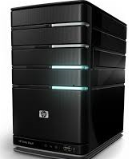
Three Site Cascade
Sync Replication
Async Replication
Source
Bunker
Target
Resiliency?
If source site lost.
If bunker site lost.

Slide 25
Three Site Multi-Target
Three site multi-target
  Source array simultaneously replicate to two target arrays
  More resilient than three site cascade. How…?
    If Bunker/source site lost then…?
Sync Replication
Bunker
Async Replication
Source
Target
Notes:
Dependancy on bunker site is not there

Slide 26
Three Site Triangle Topology
Three site triangle topology
  Standby link is used when source is failed
  Improvement over three site multi-target topology
Sync Replication
Standby link
Bunker
Async Replication
Source
Target

Slide 27
Topics
Storage Virtualization
  Virtualization = Abstraction of physical devices to logical/virtual devices
  Storage Virtualization is virtualization of virtualization
    Happens at every layer of the storage stack
Storage Virtualization Levels
SNIA Shared Storage Model

Slide 28
Storage Virtualization[1]
Storage Virtualization
  An abstraction of storage achieved by
    Hiding some details of the functions of an aggregation of storage devices and
    Presenting a uniform set of I/O services and an interface for provisioning storage

Slide 29
Storage Virtualization[2]
Storage Virtualization can be realized at different levels of abstraction
  Device Level
    Physical devices are aggregated and presented as different virtual devices (e.g. partitions, RAID controllers etc.)
  File System Level
    Block storage devices are presented as file systems
Question: In each case, what is hidden, what is made visible?

Slide 30
Storage Virtualization Levels[1]
Application speaks to filesystem or databases
File systems/databases laid out over logical volumes/partitions
Multiple LUNs configured as a single logical volume
Logical Units (LUN)
Storage Network virtualized
Volumes pooled together into storage pools
Physical drives carved into RAID-protected volumes
Virtualized (simplified) LBA view of physical disk drive
Disk drives specifies (platters, tracks, sectors)

Slide 31
Storage Virtualization Levels[2]
Due to multiple Layers of virtualization
  Applications/databases, file-system or even operating system don’t have any idea where on disk its data is getting stored…!
    e.g. local file system address maps on a logical volume, which maps to an address on a LUN, which maps to pages in a pool, which map to blocks on a logical device on a RAID group, which map to LBA addresses on multiple physical drives, which finally map to sectors and tracks on drive platters

Slide 32
SNIA (Storage Networking Industry Association) Shared Storage Model
Three layer architecture
  File/Record Layer
    Database
    Filesystem
  Block Aggregation Layer
    Host
    Network
    Device
  Storage Devices layer
Application
File/Record Layer
DBMS
File System
Block Aggregation
Host
Network
Device
Storage Devices
Notes:
Storage network Industry Association

Slide 33
Storage Virtualization Types
Host-based Virtualization
Network-based Virtualization
Storage-based/Controller based Virtualization

Slide 34
Topics
Storage Virtualization Types
  Host-based Virtualization
  Network-based Virtualization
  Storage-based/Controller based Virtualization
    In-band and Out-of-band virtualization
Software Defined Storage (SDS)

Slide 35
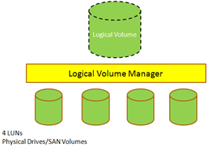
Host-based Virtualization
Implemented via Logical Volume Manager
Volume managers work with block storage
  e.g. DAS or SAN
Virtualizes multiple block I/O devices into logical volumes
  Take devices from the lower layer and creates LVs
  These LVs made available to higher layers, where file systems are written to them
  LVs can be sliced, striped, and concatenated
  Limited in scalability due to Host centric - not easily sharable among other hosts

Slide 36
Network-based/ SAN based Virtualization
Not successful e.g. EMC Invista
Storage virtualization at the network layer requires intelligent network switches, or SAN based appliances to perform functions like-
  Aggregation and virtualization of storage arrays
  Combining LUNs from heterogeneous arrays into a single LUN
  Heterogeneous replication at the fabric level

Slide 37
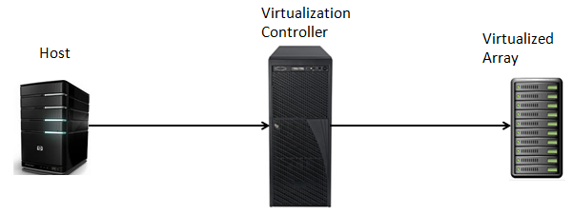
Storage based Virtualization
It is predominant form of virtualization in the real world
In Band Virtualization (Symmetric)
  Controller sits between the host issuing the I/O and the storage array that is virtualized
    Virtualization function is transparent to the host
  Doesn’t requires any driver or software on the storage array
  I/O, command and metadata pass through the controller
Notes:
Can be used to bridge protocols

Slide 38
Out-of band Virtualization
It is asymmetric
Only command and metadata pass through the virtualization device (controller)
Requires HBA drivers and agent software deployed on the host to communicate with the controller
  to get the accessibility information

Slide 39
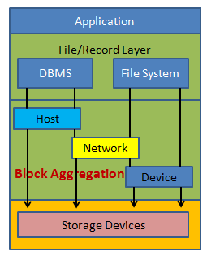
Controller Based Virtualization
Controller based virtualization occurs at the device layer
  Called as block based in-band virtualization
  Controller has all of the intelligence and functionality
  The array being virtualized just provides dumb RAID protected capacity with some cache
  The controller takes the write request and send the ACK to host
  It writes to an array asynchronously based on cache algorithm

Slide 40
Controller Virtualization Configuration
Array configuration
  LUNs on the virtualized array are presented out to the WWPNs of the virtualization controller
  The controller claims these LUNs and use them as storage (e.g. formed into a pool)
  Volumes are created from the pool
  Volumes are presented to hosts as LUNs through front-end ports
Controller Configuration
  Configure front-end ports into virtualization mode
  This enables these ports to discover and use LUNs of Array being virtualized
  These ports usually emulate a standard Windows or Linux host

Slide 41
Benefits of Storage Virtualization
Management
  Multiple technologies from multiple vendors can be virtualized and managed through a single management interface
Functionality
  e.g. snapshots and replication, of the higher tier array can be extended to the capacity provided by the lower tier array
Performance
  e.g. addition of drives behind the virtual LUN
Availability
  e.g. RAID groups are used to create RAID protected LUNs, array based replication and snapshot technologies also add to the protection provided by the virtualization
Technology Migrations/refresh
  Easy to migrate from one storage array to another storage array
Cost
  We can virtualize lower performance storage array behind higher performance storage array

Slide 42
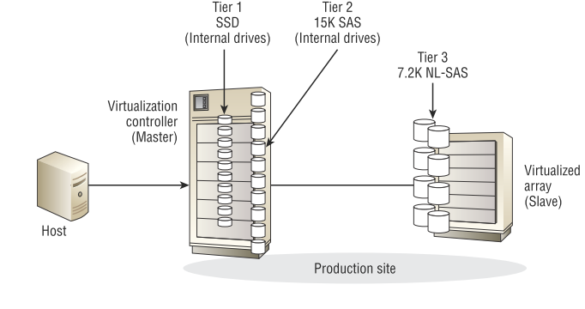
Storage Virtualization and Auto-tiering
Tier-1 Array (Internal- in controller)
  High performance SSD Drives
  Highest in the performance with least latency
Tier-2 (Internal- in controller)
  15K SAS drives
Tier-3 (External-In virtualized array)
  7.2K NL-SAS
  Least in the performance with high latency
Figure source: Data Storage Networking, Sybax Wiley

Slide 43
Software Defined Storage (SDS)
Traditional Storage
  Hardware (physical drives) and software (intelligence and functionality) are tightly coupled
  Vendor specific
Software Defined Storage
  Use of VSA (Virtual Storage Appliance)-> Intelligent storage controller implemented as pure software as VM
  Decouples the hardware and software (intelligence)
  Vendor agnostic
  Scalable and compatible with the cloud

Slide 44
SDS Architecture
Orchestration
Decoupled
Data Services
Decoupled
Hardware

Slide 45
Topics
Backup and Recovery
  One of the major business continuity plan activity
  Recovery is more important then Backups
  If the business can’t go backward after a disaster, it can’t go forward.
Backup methods
  Hot (aka Online)
  Offline
  LAN based
  SAN based

Slide 46
Recovery Point Objectives (RPO)
What is RPO…?
  It is the point in time to which a service can be restored/recovered
  For example a backup schedule that backs up a database every day at 2 a.m. can recover that database to the state it was in at 2 a.m. every day
  For example RPO for tape based backup is -
    Minimum 24 hrs
  If more-granular RPOs are required, traditional backups can be augmented with technologies such as snapshots

Slide 47
Recovery Time Objective vs. Recovery Point Objective
RPO is that you can recover a system or application to how it was within a certain given time window
RTO states how long it will take you to do that
Example: It takes 8 hours to recover a system to the state it was in 24 hours ago

Slide 48
Backup Window
A backup window is a period of time—with a start and stop time—during which data can be backed up
  For example, a backup window might include all noncore business hours for a certain business, such as 11 p.m. until 9 a.m.
  Why backup window requires…?
    Negative impact on the system during backup

Slide 49
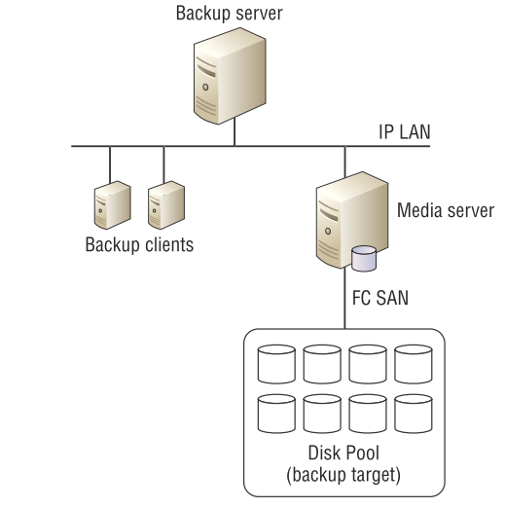
Backup Architecture: Example
The backup server monitors the backup schedule.
When the schedule indicates that a particular client needs backing up, the backup server instructs the agent software on the backup client to execute a backup.
The backup server sends the data over the IP to the media server.
The media server channels the incoming backup data to the backup target over the FC SAN that it is connected to.
Fig. source: Data Storage networks by Nigel Poulton

Slide 50
Backup Methods: Hot Backups and Offline Backups
Online backups (i.e. application is servicing users)
  Reduces administrative overhead and allow backup environments to scale because they don’t require administrative stops and restarts of applications
  Provides ability to perform integrity checks against backups
Offline Backups
  Require applications and databases to be taken offline for the duration of the backup
  Not used in today’s time!!!

Slide 51
Backup Methods: LAN Based Backups
Cheap and convenient!
Sending backup data over the LAN
  Often low performance with a risk of impacting other traffic on the network
  Can be dedicated VLAN or dedicated physical network or can be main production network

Slide 52
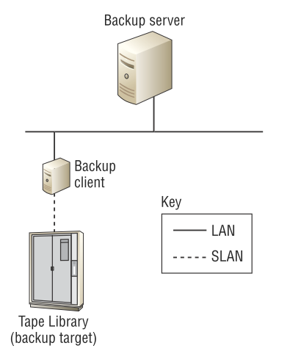
Backup Methods: LAN Free Backups
Data is passed from the backup client to the storage medium over the SAN
Block based backup and faster than file based backups
Restore is complex
  Required to restore the entire backup to a temporary area and then locate the required file and copy it back to its original location.
Fig. source: Data Storage networks by Nigel Poulton

Slide 53
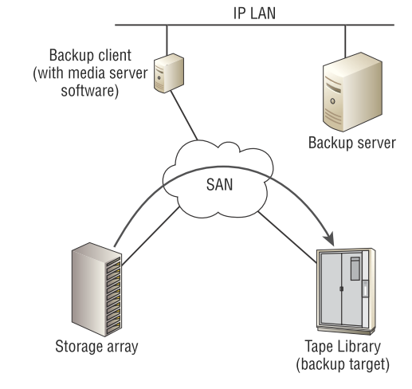
Backup Methods: Server less Backups
Don’t utilize server resources (i.e. LAN Free)
Use the SCSI-based EXTENDED COPY command
  This allows data to be copied directly from a source LUN to a destination LUN
Fig. source: Data Storage networks by Nigel Poulton
Notes:
The backup server tells the backup agent software on the backup client machine to initiate a server-less backup with the tape library specified as the target.
A SCSI EXTENDED COPY command is utilized to copy the data directly from the storage array to the tape library via the SAN.
Metadata about the job is passed over the IP LAN to the backup server. This metadata includes job details such as start time, completion time, completion code, and so on.

Slide 54
Network Data Management Protocol (NDMP)
Network Data Management Protocol (NDMP) is a protocol designed for standard-based efficient NAS backups
  Data can be sent directly from the NAS device to the backup device without having to pass through a backup media server.
  Without NDMP, NAS-based file shares would have to be mounted on a backup media server to be able to be backed up
  Windows and Linux servers don’t need NDMP
    NAS arrays run custom operating systems that can’t normally have backup agent software installed on them

Slide 55
Topics
Backup Types
  Full
  Incremental
  Differential
  Synthetic
  Application aware

Slide 56
Full Backups
A backup in which all of a defined set of data objects are copied, regardless of whether they have been modified since the last backup
  They offer the best in terms of restore speed and restore simplicity.
  Consume the most backup space on the backup target device
  Use the most network bandwidth and server resources
  Also takes the most time as well

Slide 57
Incremental Backups
An incremental backup is defined as a job that backs up files that have changed since the last backup...
  and that “last backup” could be an incremental backup or a full backup
A full recovery requires the most recent full backup plus all incremental backups since the full backup

Slide 58
Cumulative Incremental Full Backups
Only back up the data, that has changed since the last full backup
  So, in the first place, you need a full backup, and from there on, you can take cumulative incremental backups
Most cumulative incremental backup solutions will back up an entire file even if only a single byte of the file has changed since the last backup

Slide 59
Differential Incremental Backups
Like cumulative incremental backups, differential incremental backups work in conjunction with full backups
But instead of backing up all data that has changed since the last full backup, differential incremental backups, back up only changed data since the last differential incremental.
These are excellent at “space efficiency”

Slide 60
Synthetic Full Backup
A synthetic full backup works by taking a one-time full backup and then from that point on taking only incremental or differential backups
Synthetic full backups referred to as a form of incremental forever backup system

Slide 61
Application Aware Backups
Application-consistent backups (form of hot backups)
  e.g. Flushing local buffers, applying logs, setting any application flags for smooth recovery
Enable to restore your applications from your backups
Application-aware backups usually require installing special agent software on the application server
  Such as installing an Exchange Server agent on the Exchange server

Slide 62
Topics
Backup Target Devices
  Tape devices
  Virtual Tape Libraries
  Disk Pools
  Cloud Services
Backup retention policies and Archiving

Slide 63
Backup to Tapes
Oldest and most common form of backup…!
Advantages
  High capacity
  High sequential performance
  Low power
Disadvantages
  Media degradation
  Technology refresh
    Lack of software to read from old backups
  Discomfited for some restore types
    e.g. differential backups, incremental backups

Slide 64
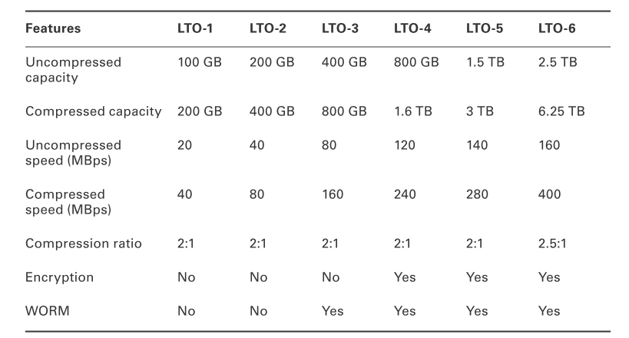
Linear Tape Open Format (LTO) Technology
Table Source: Data Storage networking by Nigel Poulton

Slide 65
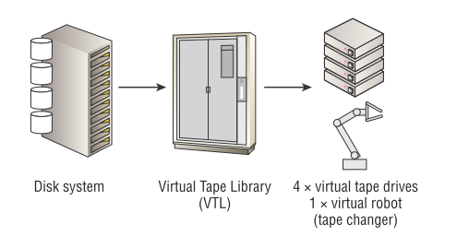
Virtual Tape Library (VTL) Emulation
At a high level, VTL technologies take disk-based storage arrays and carve them up to appear as tape libraries and tape drives—hence the name Virtual Tape Library
  It is disk pretending to be tape
  Pros: Existing backup software could talk to it.
Fig. source: Data Storage networks by Nigel Poulton

Slide 66
Backup to Disk: Disk Pools
Advantages over tapes
  Superior random access
  Superior concurrent read and write operation
    Good for synthetic full backups, where the system is both reading and writing during the creation of the synthetic full backup image
  Better reliability
    Can be protected by RAID technologies

Slide 67
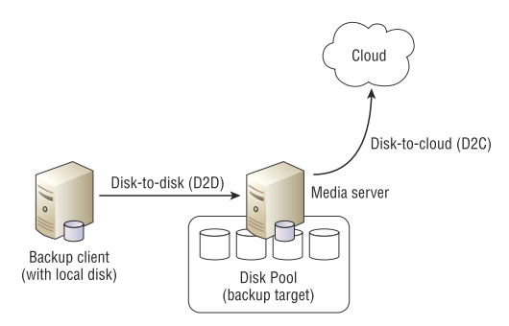
Backup to the Cloud
Cloud is ideal for Backup and recovery
  Don’t need fast and frequent access
  How to get backup data to the cloud?
    Disk-to-Disk-to-Cloud (D2D2C)
    D2D portion of it is in your data center (local)
Fig. source: Data Storage networks by Nigel Poulton

Slide 68
Backup Retention Policies
Grandfather-Father-Son (GFS) scheme
  Grandfather (monthly backups)
  Father (Weekly backups)
  Son (Daily backups)
  Example
    Monthly backups: Keep for 60 months
    Weekly backups: Keep for 52 weeks
    Daily backups: Keep for 28 days
  Monthly and weekly full backups are taken off-site and keep daily incremental backup on-site

Slide 69
SLA based on Retention Policies
1. All data from the last 28 days can be restored from the previous night’s backup (RPO), and can be restored within one working day (RTO).
2. All data between 28 and 365 days old can be restored to the nearest Friday night backup of the data (RPO), and can be restored within two working days (RTO).
3. All data between 1 year and 5 years old can be restored to the nearest first Friday of the month (RPO), and can be restored within two working days (RTO).

Slide 70
Backup vs. Archiving
Backups are intended to protect data that is currently or recently in use.
Backups provide medium to fast recovery of this data, usually in the event that it’s lost, deleted, or corrupted.
Backups deal with operational recovery of files, folders, applications, and services.
Archiving is used to efficiently store data that is no longer used, or only very infrequently used, but needs keeping.
Archiving is used for legal compliance requirements

Slide 71
Topics
Storage Management Areas
  Capacity, Performance, Availability
Capacity Management
  Make sure you always have enough capacity to service your applications!
  Capacity utilization is in best way
  Requires Reporting and Trending

Slide 72
Capacity Management
Capacity management in FC-SAN based storage
  SAN switches
  SAN ports
  SAN bandwidth
  Inter-switch links
  Front-end array ports
  Data center power and cooling
  Data center floor space
  Licenses for usable capacity
  Many more….

Slide 73
Capacity Reporting
What is using up storage in the shared corporate space?
  Production-Live
  Production-Disaster Recovery
  Development
  Research
  …

Slide 74
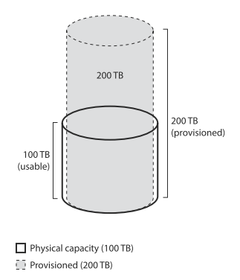
Thin Provisioning Considerations
Over provisioning
  Allows us to pretend we have more storage than we really do
  It involves RISK..?
Fig. Source: Storage Area Networks by Nigel Poulton

Slide 75
The Need for Trending
Start out by over provisioning by a small percentage i.e. 10-20 percent
Then trend and forecast for next few months say 4 to 6 months
Once you have a good idea of the capacity related characteristics, over provisioning can be increased up-to 40 percent
Keep trending and forecasting, and repeating the cycle
The key here is to understand the growth and characteristics of your environment
There is no thumb rule for this!!!

Slide 76
Key Metrics for Trending
Physical Capacity
  Usable capacity of the array
Provisioned Capacity
  How much you are pretending to have
Used Capacity
  Amount of the capacity hosts have actually written
Each of these metrics must be known and tracked individually for each of array you have

Slide 77
Example: Trending
Physical Capacity: 100 TB
Provisioned Capacity: 150 TB
Actual used Capacity: 50 TB
Over provisioned Percentage: 50 %
Trend:
  Used capacity is increasing by 5TB per month
Notes:
Trending for future business trends

Slide 78
De-duplication and Compression
Tracking how effective these technologies are useful for reporting purpose
De-duplication effectiveness is expressed as a ratio
  e.g. 4:1 and 10:1
  From capacity management point of view, there is a big difference between inline and post process de-duplication technologies
Conversion ratios to percentage space saved
  10:1 is converted as 100-(1*100/10) = 90 %
  25:1 is converted as 100 – (1*100/25) = 96 %
Notes:
4:1 = We have stored 4 times as much data as we would have

Slide 79
Topics
Performance Management
  Ensuring that your storage estate is high performance
  Identifying performance bottlenecks
  Tuning performance

Slide 80
Performance Management
It is about the optimal performance of the entire storage estate
  Storage arrays
  Network
  NICs
  HBAs
  Volume managers
  Multi-pathing software

Slide 81
Base-lining
To troubleshoot a suspected performance issue, a frame of reference is must to compare it with the system--- called base-lining
“Performance” is an application dependent
  e.g. 15000 IOPS with a response time of 15 ms may be good for some applications and bad for some other applications
This can be decided on base-lining. How???
Notes:
Keep copy of the same stats when there was no perceived performance issue

Slide 82
Latency/Response Time
Biggest performance killer!
Time to send a command and to get the response – is referred as response time
  Any delay imposed on response time is called latency
Latency can occur at just about every layer in the design
  Host: File system, volume manager, HBA
  Network: SAN or IP network, inter switch links
  Storage array: Array front end ports, cache, backend, replication

Slide 83
Low Latency Requirements: Examples
Trading systems
Pay as you go cell phone systems requiring account balances to be checked before connecting calls
Online shopping systems that have to perform fraud detection before processing payments

Slide 84
Performance Metric: IOPS and MBps
IOPS
  Concept of IOPS is vague.
  What exactly is an I/O?
  Are all I/Os equal?
    Read vs. Write, Random vs. Sequential, Small vs. Big
  Used for transactional applications
MBps
  Number of Mega bytes transferred by a disk or storage array
  Used for throughput driven applications

Slide 85
Factors Affecting Storage Performance [1]
RAID
  Good for data protection but with impact on performance front
  Random small-block write workloads are slower
    e.g. RAID 5 and RAID 6
Thin LUNs
  Follows allocate on demand model
  Performance Impacts
    Can add latency as system has to identify free extents and allocate them to a volume, each time a write request comes into a new area on a thin LUN
    Can result in fragmented backend layout

Slide 86
Factors Affecting Storage Performance [2]
Cache
  Caches improve performance of spinning disk based storage
Network hops
  Leads to network induced latency
  Higher in IP/Ethernet as compared to FC-SAN
Multi-Pathing
  Prime motivation to provide high availability
  MPIO balanced out the I/O from a single host over multiple array ports

Slide 87
Standard Performance Tools
Perfmon or Performance monitor in Windows
  One can monitor host based performance counters (e.g. end to end latency)
  You can add the counters and monitor the performance
iostat in Linux
  CPU utilization
  Device utilization
  Network file system utilization

Slide 88
Topics
Performance Management
  Ensuring that your storage estate is high performance
  Identifying performance bottlenecks
  Tuning performance

Slide 89
Performance Management
It is about the optimal performance of the entire storage estate
  Storage arrays
  Network
  NICs
  HBAs
  Volume managers
  Multi-pathing software

Slide 90
Base-lining
To troubleshoot a suspected performance issue, a frame of reference is must to compare it with the system--- called base-lining
“Performance” is an application dependent
  e.g. 15000 IOPS with a response time of 15 ms may be good for some applications and bad for some other applications
This can be decided on base-lining. How???
Notes:
Keep copy of the same stats when there was no perceived performance issue

Slide 91
Latency/Response Time
Biggest performance killer!
Time to send a command and to get the response – is referred as response time
  Any delay imposed on response time is called latency
Latency can occur at just about every layer in the design
  Host: File system, volume manager, HBA
  Network: SAN or IP network, inter switch links
  Storage array: Array front end ports, cache, backend, replication

Slide 92
Low Latency Requirements: Examples
Trading systems
Pay as you go cell phone systems requiring account balances to be checked before connecting calls
Online shopping systems that have to perform fraud detection before processing payments

Slide 93
Performance Metric: IOPS and MBps
IOPS
  Concept of IOPS is vague.
  What exactly is an I/O?
  Are all I/Os equal?
    Read vs. Write, Random vs. Sequential, Small vs. Big
  Used for transactional applications
MBps
  Number of Mega bytes transferred by a disk or storage array
  Used for throughput driven applications

Slide 94
Factors Affecting Storage Performance [1]
RAID
  Good for data protection but with impact on performance front
  Random small-block write workloads are slower
    e.g. RAID 5 and RAID 6
Thin LUNs
  Follows allocate on demand model
  Performance Impacts
    Can add latency as system has to identify free extents and allocate them to a volume, each time a write request comes into a new area on a thin LUN
    Can result in fragmented backend layout

Slide 95
Factors Affecting Storage Performance [2]
Cache
  Caches improve performance of spinning disk based storage
Network hops
  Leads to network induced latency
  Higher in IP/Ethernet as compared to FC-SAN
Multi-Pathing
  Prime motivation to provide high availability
  MPIO balanced out the I/O from a single host over multiple array ports

Slide 96
Standard Performance Tools
Perfmon or Performance monitor in Windows
  One can monitor host based performance counters (e.g. end to end latency)
  You can add the counters and monitor the performance
iostat in Linux
  CPU utilization
  Device utilization
  Network file system utilization

